Slide 1

H.O.R.U.S
Heuristic Object Recognition Unified System
Sinhgad College Of Engineering
Department Of Computer Engineering
Presentation By : Group No. 53
Guided by : Prof. S. S. Pawar
Somesh Bhosale 405A015
Alim Shaikh 405A080
Parth Bhosale 405C008
Isha Goski 405C016

Slide 2
Contents
Abstract
Introduction
Literature Survey
Problem Statement
Objectives
Proposed System Architecture
Requirements
Proposed Algorithm/Methodology
Conclusion
References
Sinhgad College Of Engineering Department Of Computer Engineering

Slide 3
ABSTRACT
In these days of the 4th industrial revolution, real-time object detection and dimensioning is an important aspect from an industrial point of view. Computer Vision is a field of study that helps to develop techniques to recognize images and displays. It has different features like image recognition, object detection and image creation, etc. Using the algorithms like faster R-CNN, YOLO and SSD we can achieve a high accuracy of upto 94% for clear images and upto 76.4% accuracy for blurry images.
Keywords : Convolutional Neural Network, YOLO, CNN, object detection, OpenCV
Sinhgad College Of Engineering Department Of Computer Engineering

Slide 4
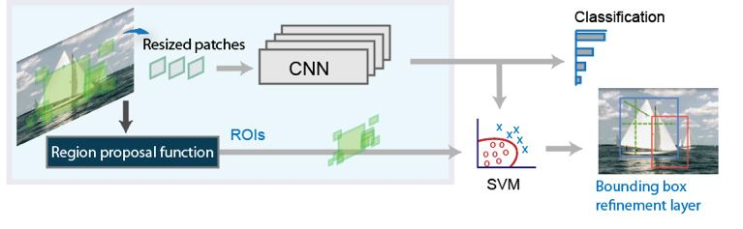
INTRODUCTION
Object detection is a computer technology related to computer vision and image processing that deals with detecting instances of semantic objects of a certain class (such as humans, buildings, or cars) in digital images and videos. You can use a variety of techniques to perform object detection. Popular deep learning–based approaches use convolutional neural networks (CNNs) such as YOLO v3.
.
Sinhgad College Of Engineering Department Of Computer Engineering

Slide 5
PROBLEM STATEMENT
In the age of 4th industrial revolution there is a need of security with the help of Artificial Intelligence. There is a need to develop a fast paced security system that uses state of art AI algorithms to detect certain set of items and provide the threat possibility of the item. Thus it becomes necessary to create a System that is capable of detecting the desired objects and is able to alert the user if certain items are detected. The algorithm used should work in real time and provide object detection continuously. The items to be detected are to be provided by the user.
Sinhgad College Of Engineering Department Of Computer Engineering

Slide 6
LITERATURE SURVEY
Sr. No. | Title | Publication | Advantages | Disadvantages | Research Gap
01 | Object Detection using Deep Learning with OpenCV and Python | Jan 2021 | Mask R-CNN indicated an incredible augmentation to the Faster R-CNN framework | Mask R- CNN is requires heavy computing power | To increase speed and decrease computing time and required power.
02 | Real Time Object Detection and Tracking Using Deep Learning and OpenCV | July 2018 | MobileNets is to optimize the latency while building small neural nets at the same time. | Largescale problems cannot be tackled by MobileNets | To increase the classification power of MobileNets
03 | Object Detection And Dimensioning Using OpenCV. | June 2022 | OPEN CV has further than 2500 optimized algorithms | Takes more time to compute image than matplotlib | To decrease time of detection in Open CV
04 | Real-Time Object Detection with Yolo | February 2019 | YOLO is more than 1000x faster than R-CNN and 100x faster than Fast R-CNN | Comparatively low recall and more localization error compared to Faster R_CNN | Decreasing Recall of YOLO.

Slide 7
OBJECTIVES
To use a CCTV camera for the input to the system.
To implement fast paced algorithms such as YOLO and faster R-CNN to detect the objects in the images received from the input
To alert the user if a certain user provided objects are detected by the algorithm
To implement the proposed system such that it is able to detect new objects using deep learning
To analyze speed and efficiency of the algorithms and select the most optimal algorithm for the task
Sinhgad College Of Engineering Department Of Computer Engineering

Slide 8
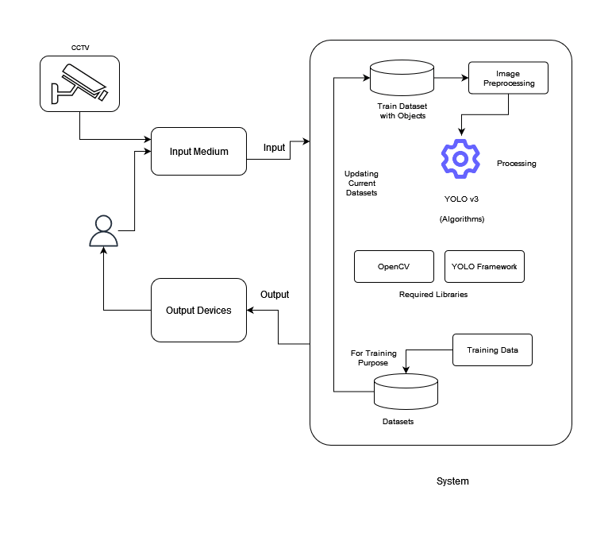
SYSTEM ARCHITECTURE
Sinhgad College Of Engineering Department Of Computer Engineering

Slide 9
REQUIRMENTS
SOFTWARE
Windows 10/11
Visual Studio Code
Python 3
Python Libraries – OpenCV, matplotlib, pandas, numpy, seaborn, sklearn
Javascript
HARDWARE
Computer or Laptop with Intel i5 processor or higher
Minimum 16 GB RAM
Minimum 4 GB Graphics Memory
(Nvidia)
CCTV camera (optional)
Sinhgad College Of Engineering Department Of Computer Engineering

Slide 10
PROPOSED METHODLOGY
Use of OPEN CV and YOLO framework.
Use of React JS for preparing the front-end of the system where user can select the objects to be detected.
Use of Python Programming language to train, implement and test the object detection model.
Object Detection in static Images and highlighting desired objects in Phase-1.
Object detection using live webcam and alerting the user if objects are detected in Phase-2.
Hardware implementation with the help of Security Camera(CCTV) in Phase-3.
Sinhgad College Of Engineering Department Of Computer Engineering

Slide 11
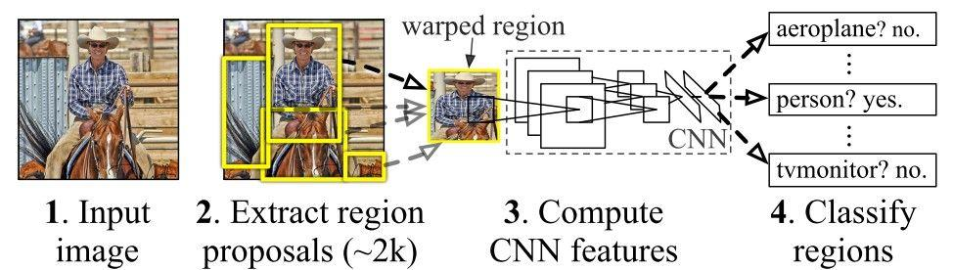
ALGORITHMS
Deep Learning
Deep Learning is a type of machine learning based on artificial neural networks in which multiple layers of processing are used to extract progressively higher-level features from data.
Algorithms for Deep Learning
YOLO:
YOLO stands for “You Only Look Once”
It is a real-time object detection algorithm that can detect objects in images or videos and identify their location within a bounding box.
Fast and Efficient.
Applications such as autonomous vehicles, security cameras, and robotics.
Sinhgad College Of Engineering Department Of Computer Engineering

Slide 12
METHODOLOGY
OpenCV
Provides a real-time optimized Computer Vision library, tools, and hardware. It also supports model execution for Machine Learning (ML).
OpenCV was built to provide a common infrastructure for computer vision applications and to accelerate the use of machine perception in the commercial products.
YOLO
You only look once (YOLO) is a state-of-the-art, real-time object detection system.
Prior detection systems repurpose classifiers or localizers to perform detection. YOLO applies a single neural network to the full image. This network divides the image into regions and predicts bounding boxes and probabilities for each region.
Sinhgad College Of Engineering Department Of Computer Engineering

Slide 13
METHODOLOGY
CUDA
CUDA stands for Compute Unified Device Architecture and is a parallel computing platform developed by NVIDIA for their GPUs (graphics processing units)
CUDA allows developers to harness the power of GPUs for general-purpose computing tasks, in addition to their traditional use in graphics rendering.
It allows for massive parallelization of computing tasks, as GPUs can perform many operations simultaneously.
Sinhgad College Of Engineering Department Of Computer Engineering

Slide 14
Implementation Stage 01: Model Creation
For this project we used the COCO(Common Objects in Context) Model which is already available on the internet and most widely used model for object recognition.
The COCO model consists of 252 hidden layers, 1 input layer, and 1 output layer. This makes it a very deep neural network, which can be beneficial for complex recognition tasks.
All the hidden layers use Leaky RELU activation function.[ The entire network is a multilayer backpropagation network.]
Sinhgad College Of Engineering Department Of Computer Engineering

Slide 15
Implementation Stage 02: Model training
COCO model can detect 80 objects on its own. In the project we have trained the model to detect a handgun which is not present in the basic 80 objects.
The following are brief steps followed during training phase:
Download images from Google Open Images Dataset using OIDv4 Toolkit.
Converting the basic pascal annotation of the images to VOC XML files using custom converter.
Converting the VOC XML files to YOLO based annotation so that the COCO model will be able to train on it.
Split the dataset in two parts train and test. Use 70% of the images for training and 30% of the images for testing.
Train the model on 70% of the images and validate the model using 30% of the images.
Sinhgad College Of Engineering Department Of Computer Engineering

Slide 16
Implementation Stage 03: Model Deployment
In this phase we tested the model if the model can detect handgun as per expectations or not.
We integrated our model with CUDA framework to increase the detection speed by using Graphics Card(GPU).
We observed that the model is almost 3.5x faster when integrated with CUDA.
Sinhgad College Of Engineering Department Of Computer Engineering

Slide 17
Implementation Stage 04: Alert Logic Building
In this phase we built logic for giving the alert using python libraries.
The Alert sub-system takes input from a text file having the list of suspicious objects. If any of the object in that list is detected in the window, then an alert is triggered.
A beep sound is used for alerting the user that suspicious object is detected.
Python Library winsound is used for this purpose.
Sinhgad College Of Engineering Department Of Computer Engineering

Slide 18
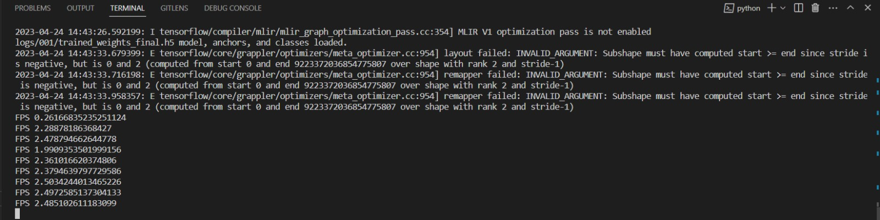
Results
In the proposed system we observed that the system gets performance improvement of upto 3.5 times when it is integrated with CUDA. Below screenshots show the FPS of object detection before and after integration with CUDA.
Fig. Before using CUDA
Sinhgad College Of Engineering Department Of Computer Engineering

Slide 19
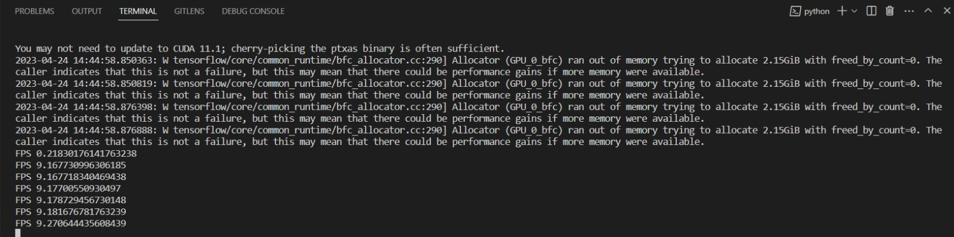
Results
Fig. After integration of the system with CUDA
Sinhgad College Of Engineering Department Of Computer Engineering

Slide 20
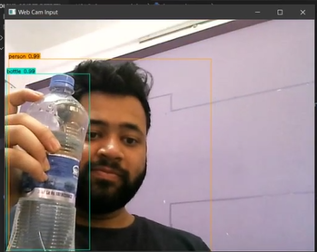
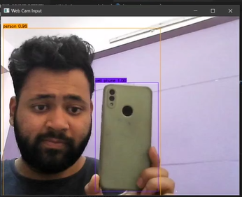
Results
Fig. Snapshots of Outcome
Sinhgad College Of Engineering Department Of Computer Engineering

Slide 21
CONCLUSION
Thus, the proposed system has the potential to detect real time objects using deep learning. The proposed project will use advanced and state-of-art libraries and algorithms to implement the object detection technology into a real time system. The proposed system will be able to alert the user if certain items are detected. It will also improve automatically over the time as user provides new items to the algorithm for detection
Sinhgad College Of Engineering Department Of Computer Engineering

Slide 22
REFERENCES
IEEE Paper: Real Time Object Detection and Tracking Using Deep Learning and OpenCV - Chandan G, Ayush Jain, Harsh Jain, Mohana
IJEAT Paper: Real-Time Object Detection with Yolo - Geethapriya. S, N. Duraimurugan, S.P. Chokkalingam.
IJCRT Paper: Object Detection and Dimensioning using OpenCV - Dr M.Mahesh, Varun Reddy, Abhishek Reddy.
Research Gate Paper: Real-Time Object Detection Using YOLO: A Review - Upulie Handalage, Lakshini Kuganandamurthy
https://towardsdatascience.com/yolo-you-only-look-once-real-time-object-detection-explained-492dc9230006
Sinhgad College Of Engineering Department Of Computer Engineering

Slide 23
THANK YOU
Does anyone have any questions?
Sinhgad College Of Engineering Department Of Computer Engineering

Slide 24
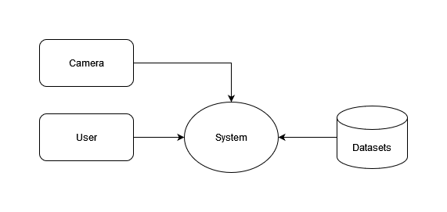
DFD Level 0

Slide 25
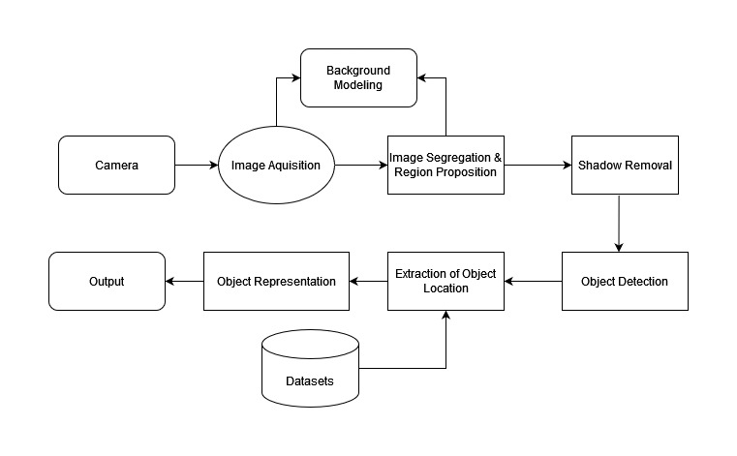
DFD Level 1

Slide 26
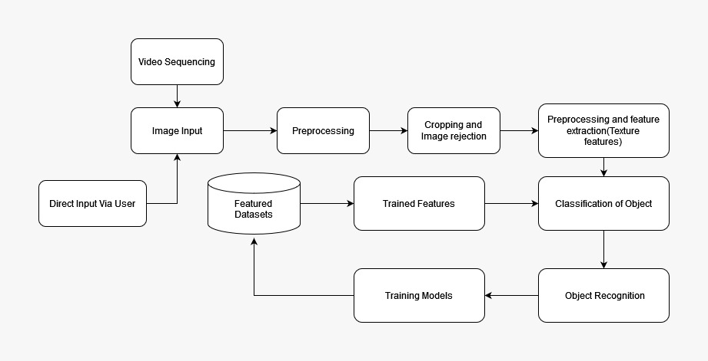
Activity Diagram

Slide 27
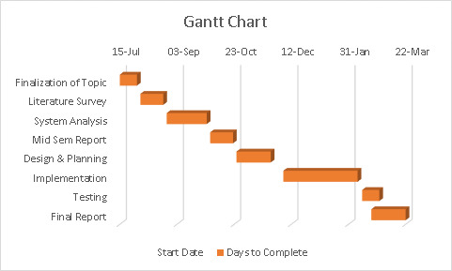
Gantt Chart

